Slide 1
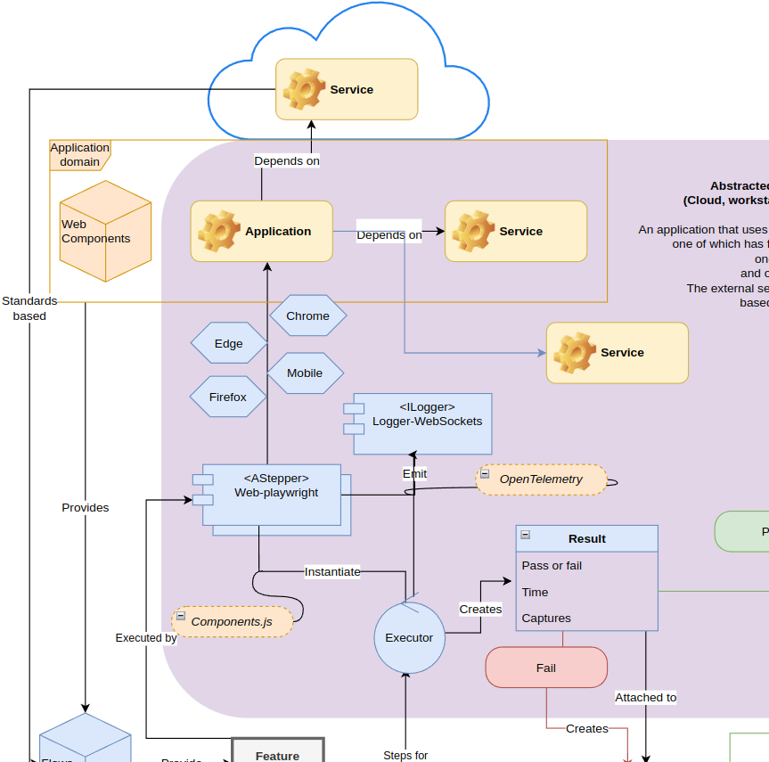
DX/UX feature integration Sept 14, 2023
Overview diagram

Slide 2
Reviews - Flow
Automated tests for functionality, accessibility
Accessibility covering “up to 80% of issues” (https://dequeuniversity.com/rules/axe/4.0) Integration via APIs with disparate, team member friendly views

Slide 3
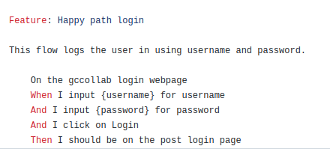
Workflow
Write scripts for each flow, bootstrapped from business decisions
Integration - Minimum of invention, cross-perspective reusability
Run them locally during dev
Incorporate in pipelines for builds, releases
Review issues in build review
Keep release reviews
Automatically create assigned issues for problems

Slide 4
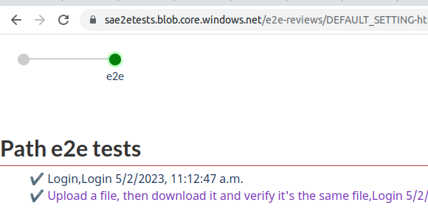
Reviews - Overview

Slide 5
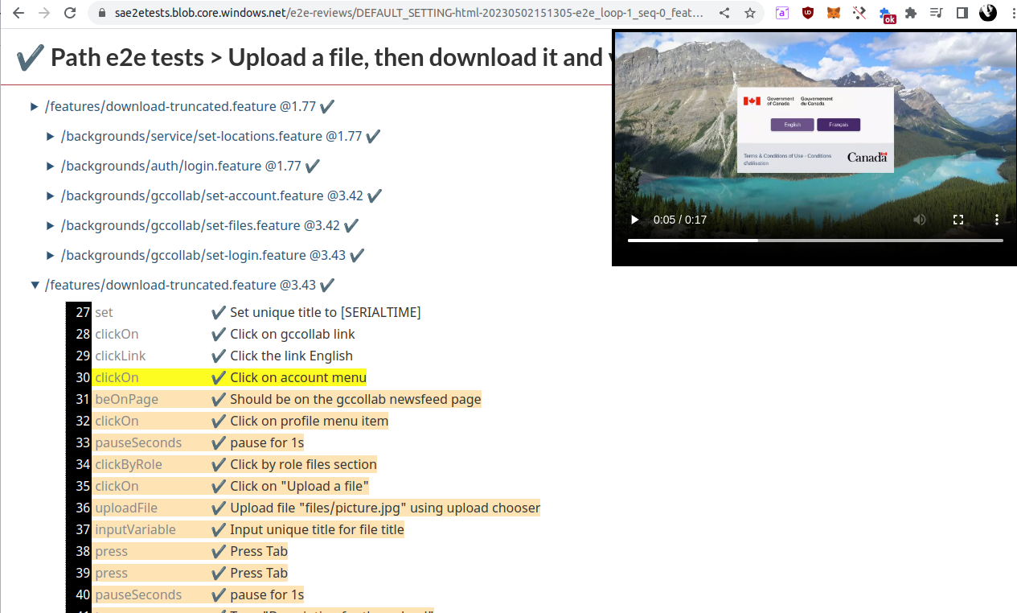
Reviews - Flow

Slide 6
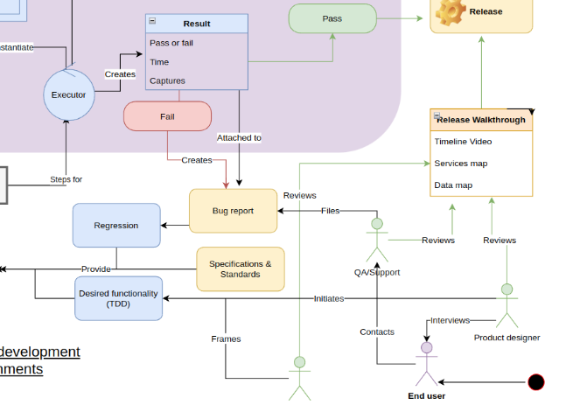
Concept
Make it easy for everyone on the team to understand and participate in workflow

Slide 7
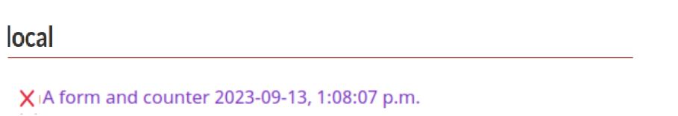

Concept - Overview
One link to engage with project progress Underlined text leads to specific views
Accessibility: 1 serious, 1 moderate "And I click the button Submit"
#134 Moderate: Ensures every ARIA input field has an accessible name; 18 hours ago; 1 PR, 2 comments, 1 preview
#135 Serious: Ensures all page content is contained by landmarks; 2 days ago
Functionality: 1 failure Should see "Uploaded file"
#142 Did not see "Uploaded file" in 30 seconds; 2 days ago

Slide 8
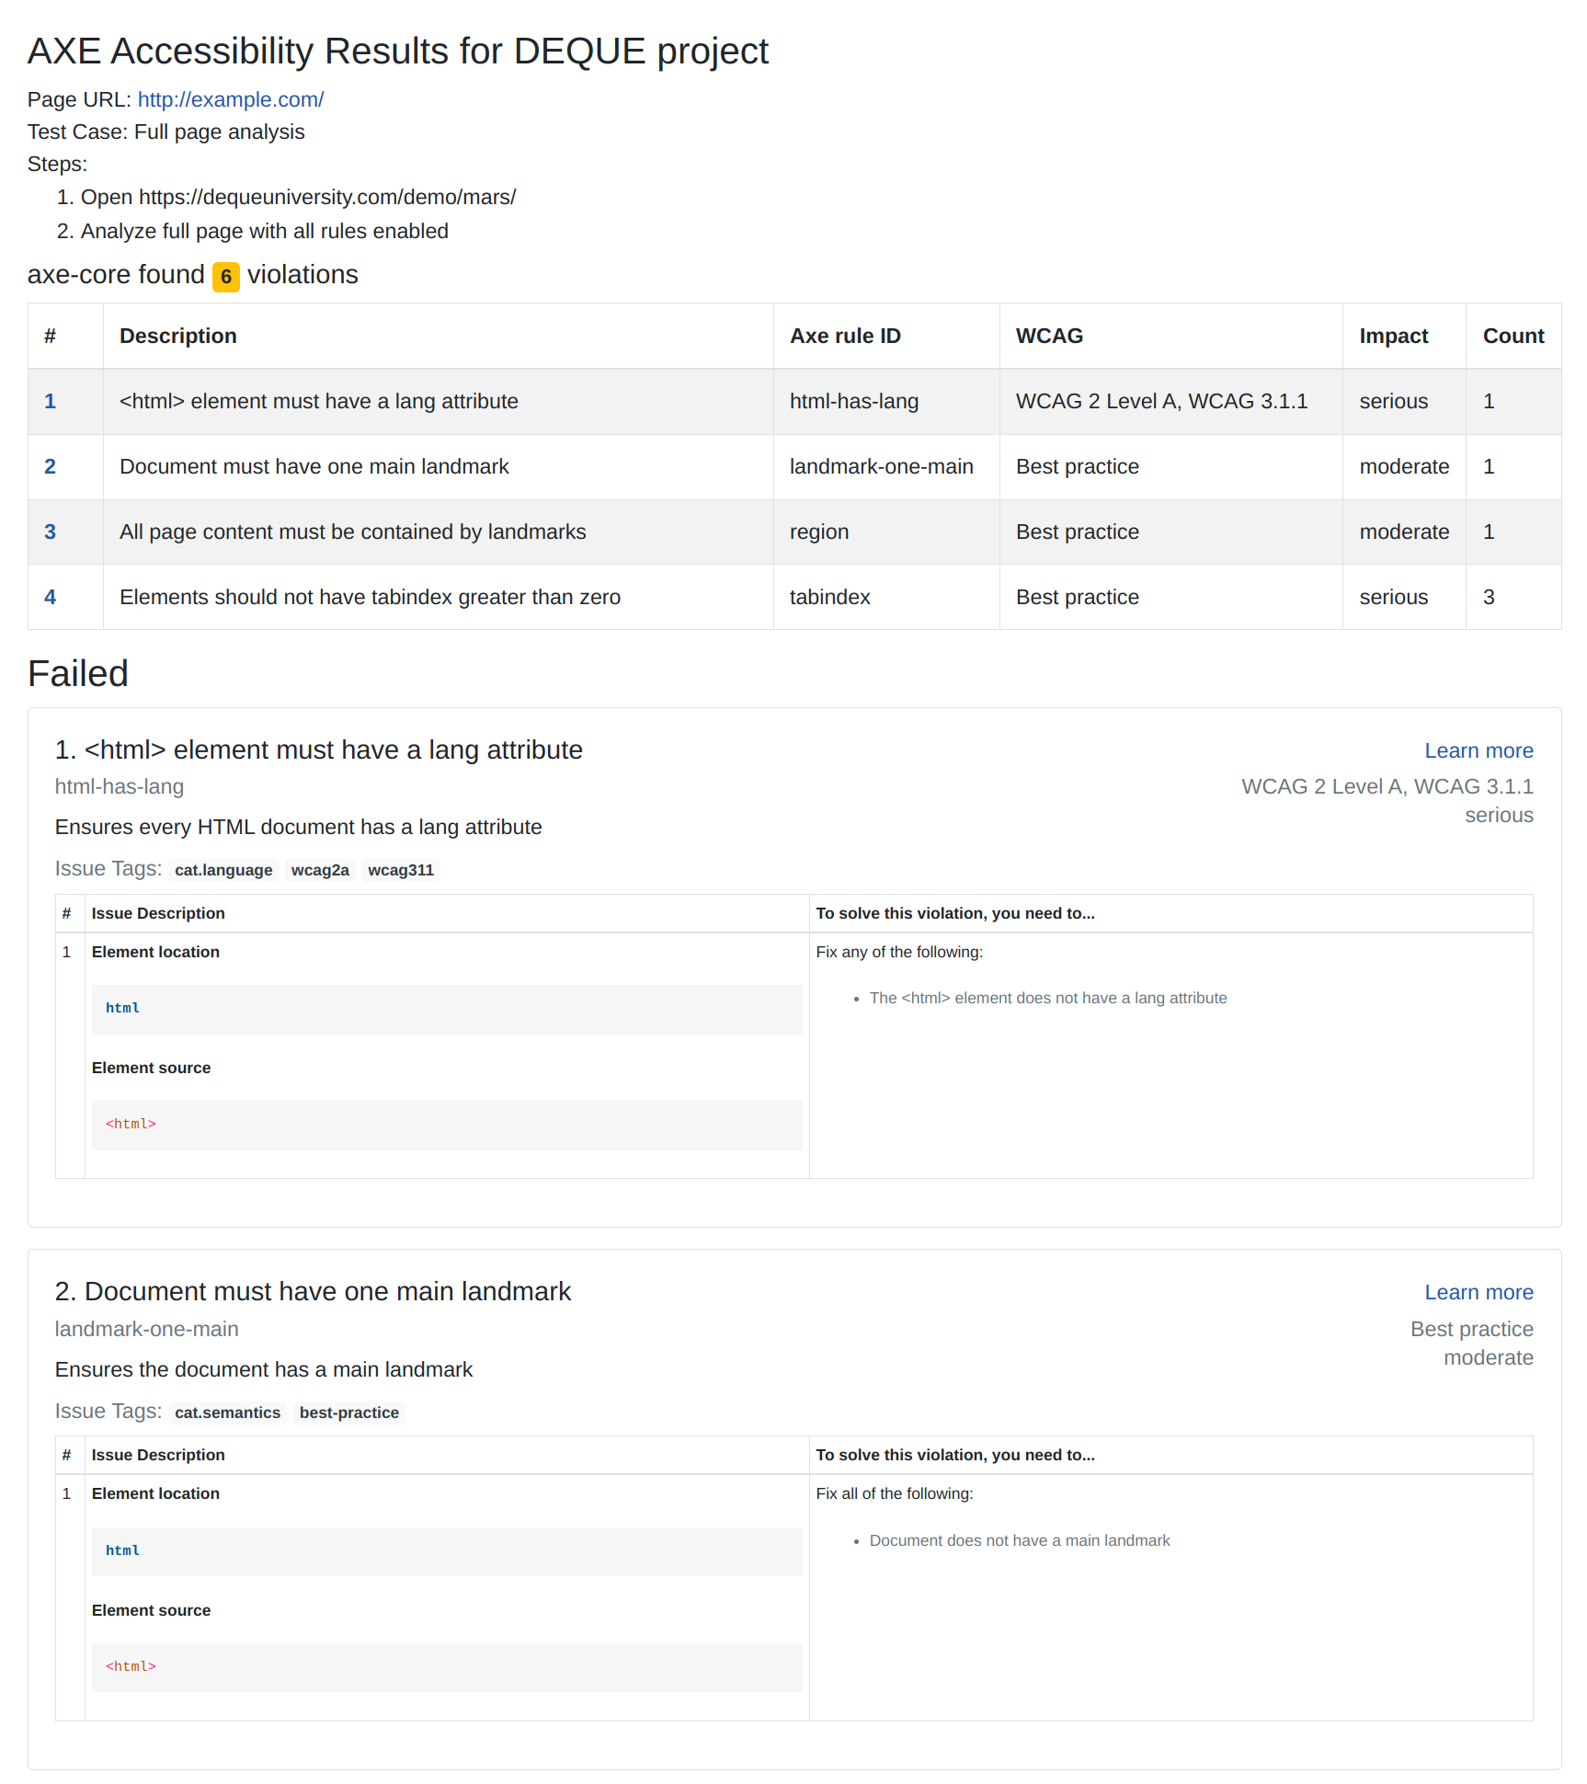
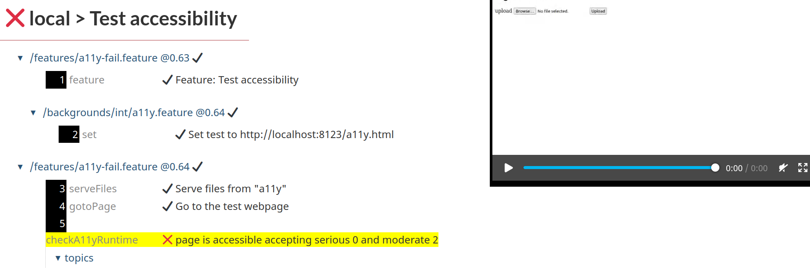
Toggle back to stepper video
🎥
Concept
Specialized views such as AXE report would appear on right

